Slide 1
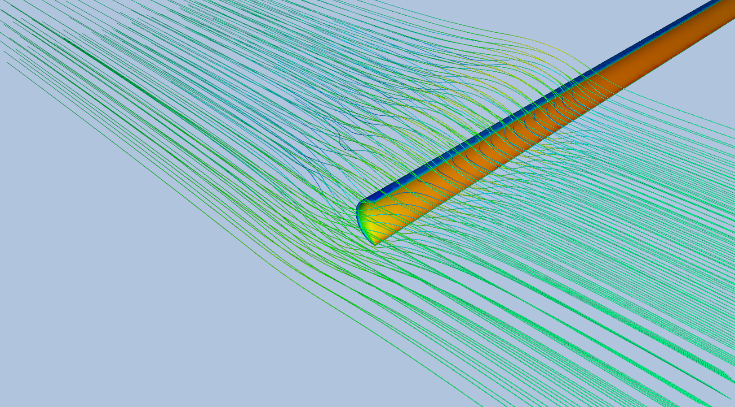
River Trash Collector:
A Novel Approach
Voon Zhi Kai Tristan
Fang Qian
Rusyaidi Bin Rashid

Slide 2

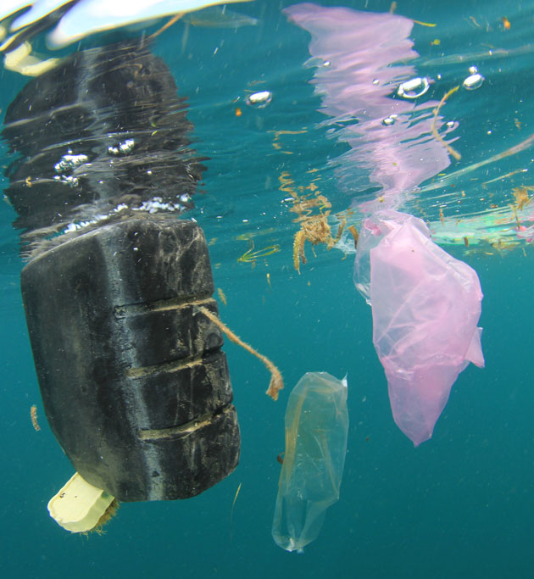
Problem statement
Our rivers are getting way too polluted!!!
About 8 Million Tons of Plastic enters the ocean from our rivers each year
In Singapore alone, 200 to 400kg worth of trash is dumped into the Singapore river everyday

Slide 3
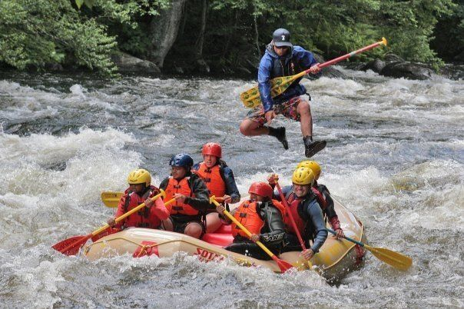


Why is this a problem???
- River litter destroys marine life and ecosystems:
Plastic and organic litter alters the marine habitat structurally and reduces sunlight that reaches to the river bed
Microplastics and other toxic compounds can form and further harm wildlife
In short, Plants and fishes die. Not good!
- You can’t enjoy the river as well
Recreational value of the waterway is lowered as a result of the amount of waste in it
The economic impact of this can be felt especially if outdoor tourism is a significant contributor to the local economy
Yes we got this from minecraft

Slide 4
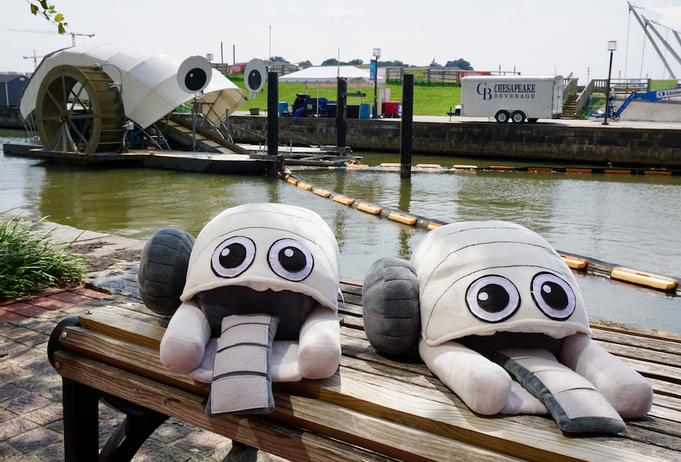
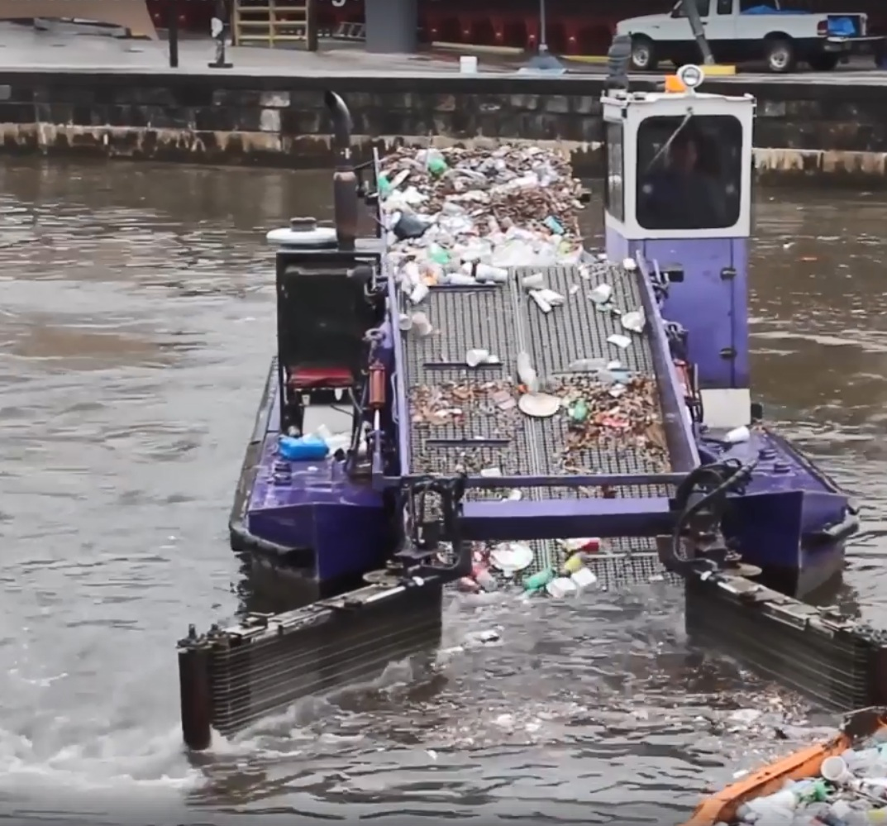
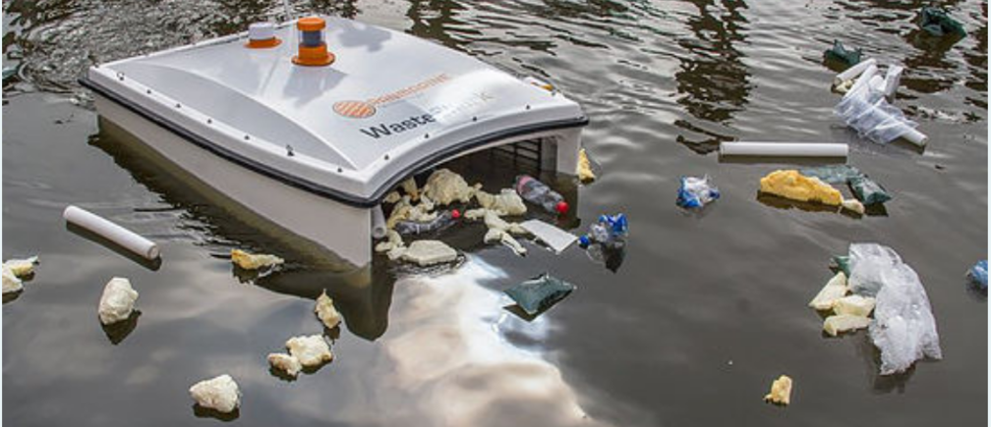
Okay, is there anything that has been done about it?
Of Course! different types of systems have been created to solve the issue
Fixed platform: Mr Trash Wheel
Installed in Baltimore Harbour, USA
Collects trash through a conveyor system with rakes
System powered by a combination of water flow and solar power
Floating buoys that spans the width of the river guide the trash to the conveyor system
Floating Platforms
Some manned, but smaller unmanned variants are underway
Collection methods varied, some conveyor based, some ‘swallow’ trash
Fuel or battery powered
Manoeuvrable, no flow guides or buoys

Slide 5
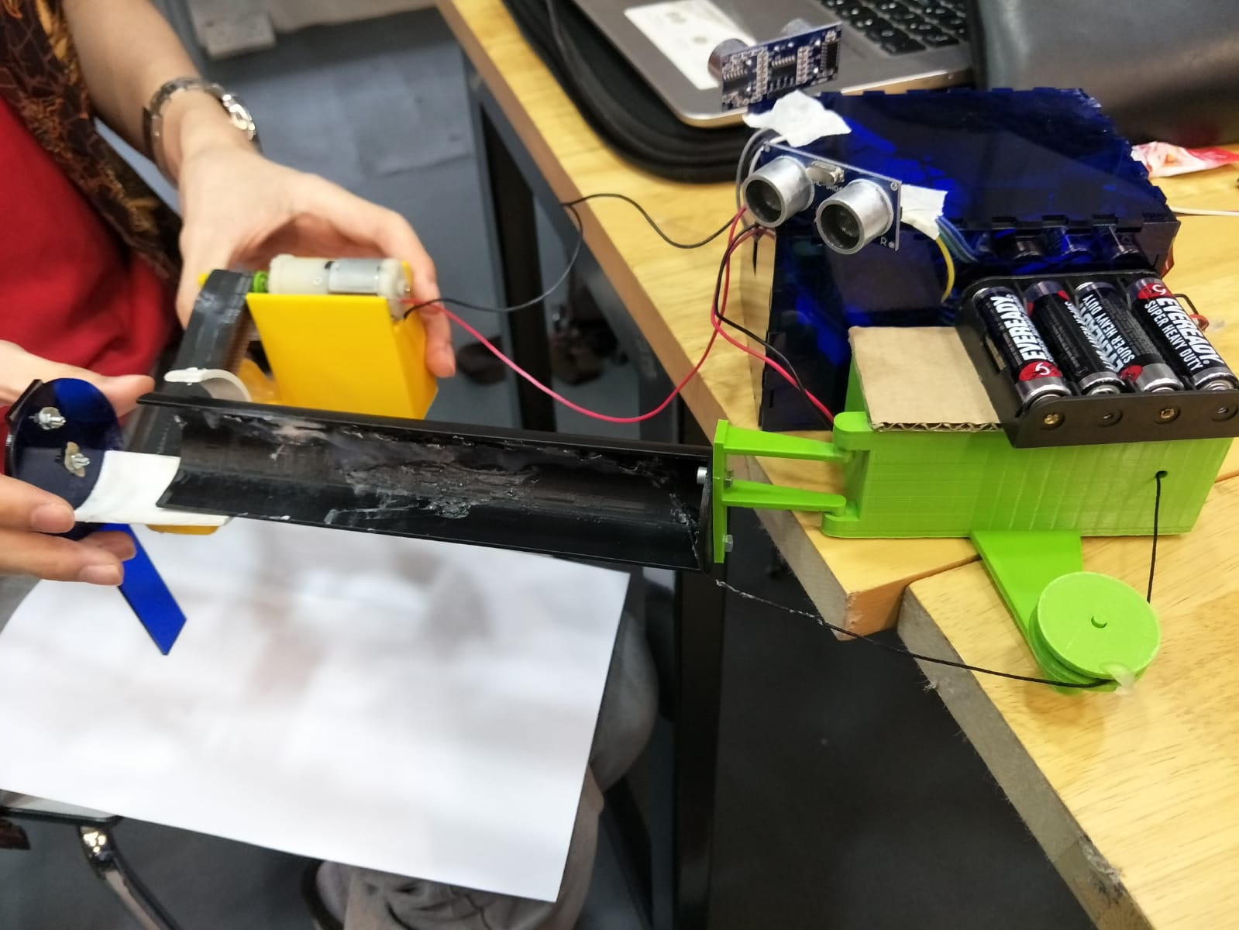
Our Solution?
The River Trash Collector System (RTCS)!
Featuring…
Automated collection of trash
Detection of incoming vehicles
Retractable components to allow free access to waterways
Ecologically Friendly (fishes don’t die!)

Slide 6
Collection subassembly
Trash Holding Area
Retractable Flow Guide Subassembly
Retractable Flow Guide Subassembly
Retractable Flow Guide Subassembly
Flow Stopper
M
Retractable Flow Guide (RFG)
Retractable Flow Guide (RFG)
Motor Housing
Motor Housing
Conveyor Belt Motor
Motor Housing
Flow Guide Pivot Point
Flow Guide Pivot Point
Flow Guide Retraction Motor
Flow Guide Retraction Motor
Flow Guide Retraction Motor
M
M
Retraction Cable
Retraction Cable
Retraction Cable
Pulley
Pulley
Pulley
Microcontroller Unit and holder

Slide 7
Retractable Flow Guide Subassembly
Functions:
Controls river flow to direct floating waste into collector subassembly
Stores retraction motor and winch drum
Pivot point for flow guide
Flow Stopper
Flow Guide Pivot Point
Flow Guide Pivot Point
Microcontroller Unit and holder
Microcontroller Unit and holder
Retractable Flow Guide (RFG)
Retractable Flow Guide (RFG)
Motor Housing
Motor Housing
Flow Guide Retraction Motor
Flow Guide Retraction Motor
Retraction Cable
Retraction Cable
Pulley
Notes:
Talk about the motor housing as well

Slide 8
Trash Flow
M
M

Slide 9
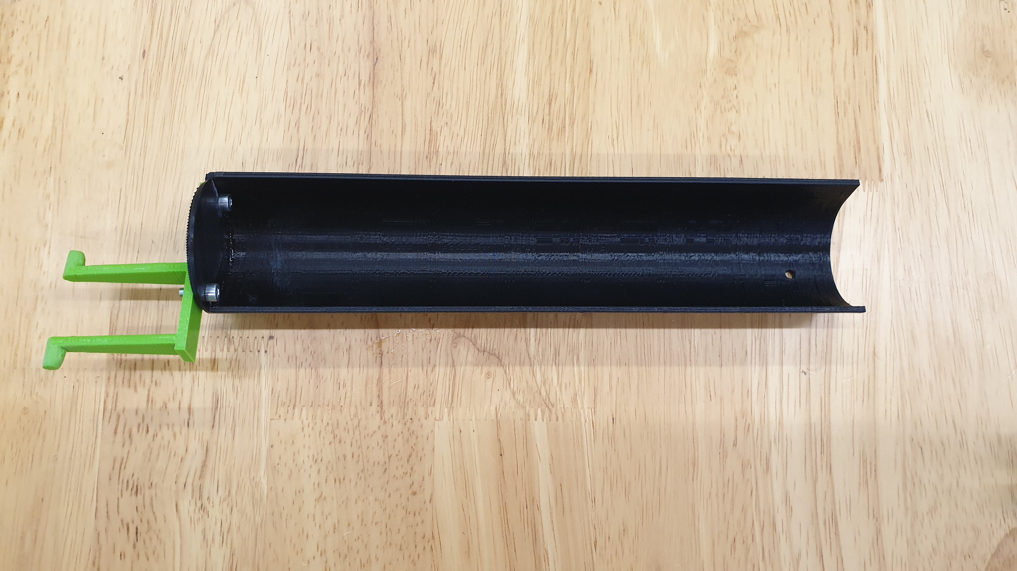
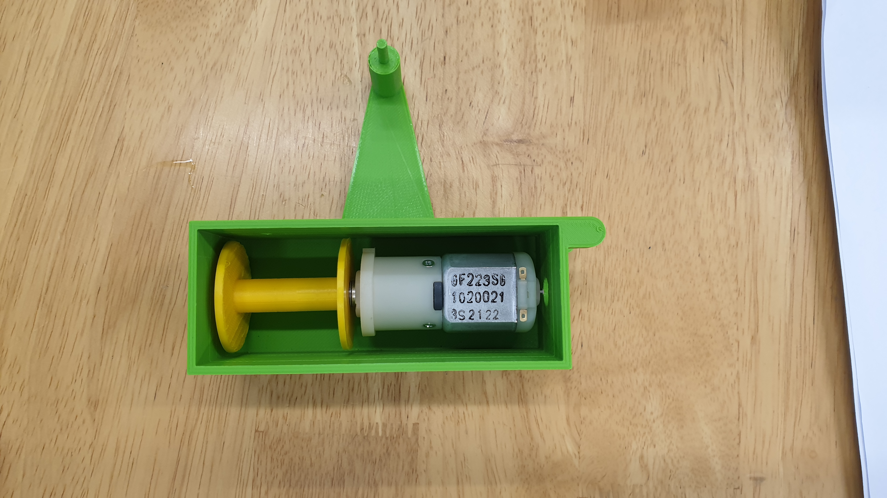
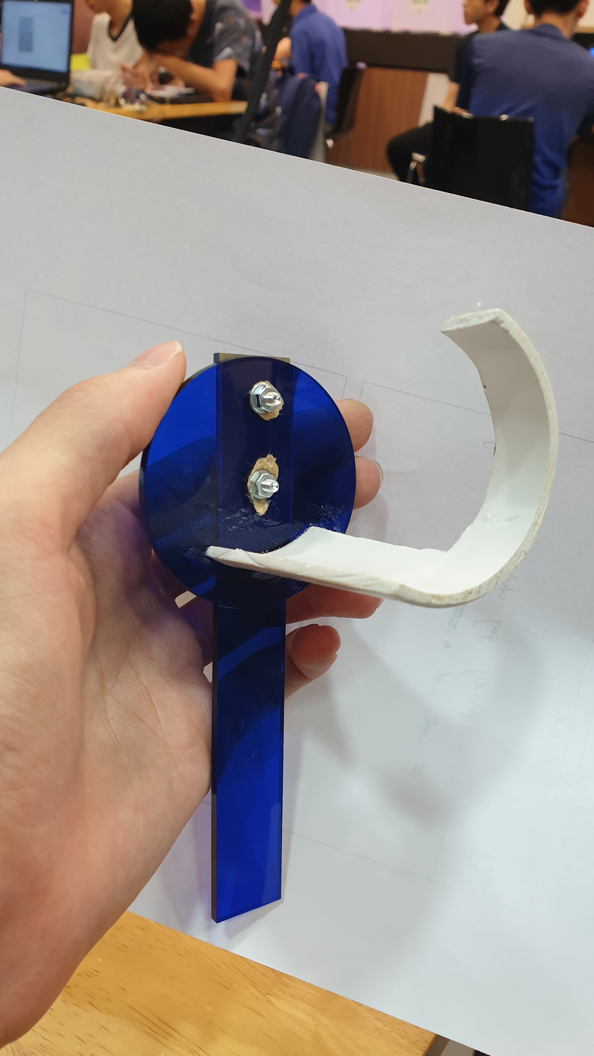
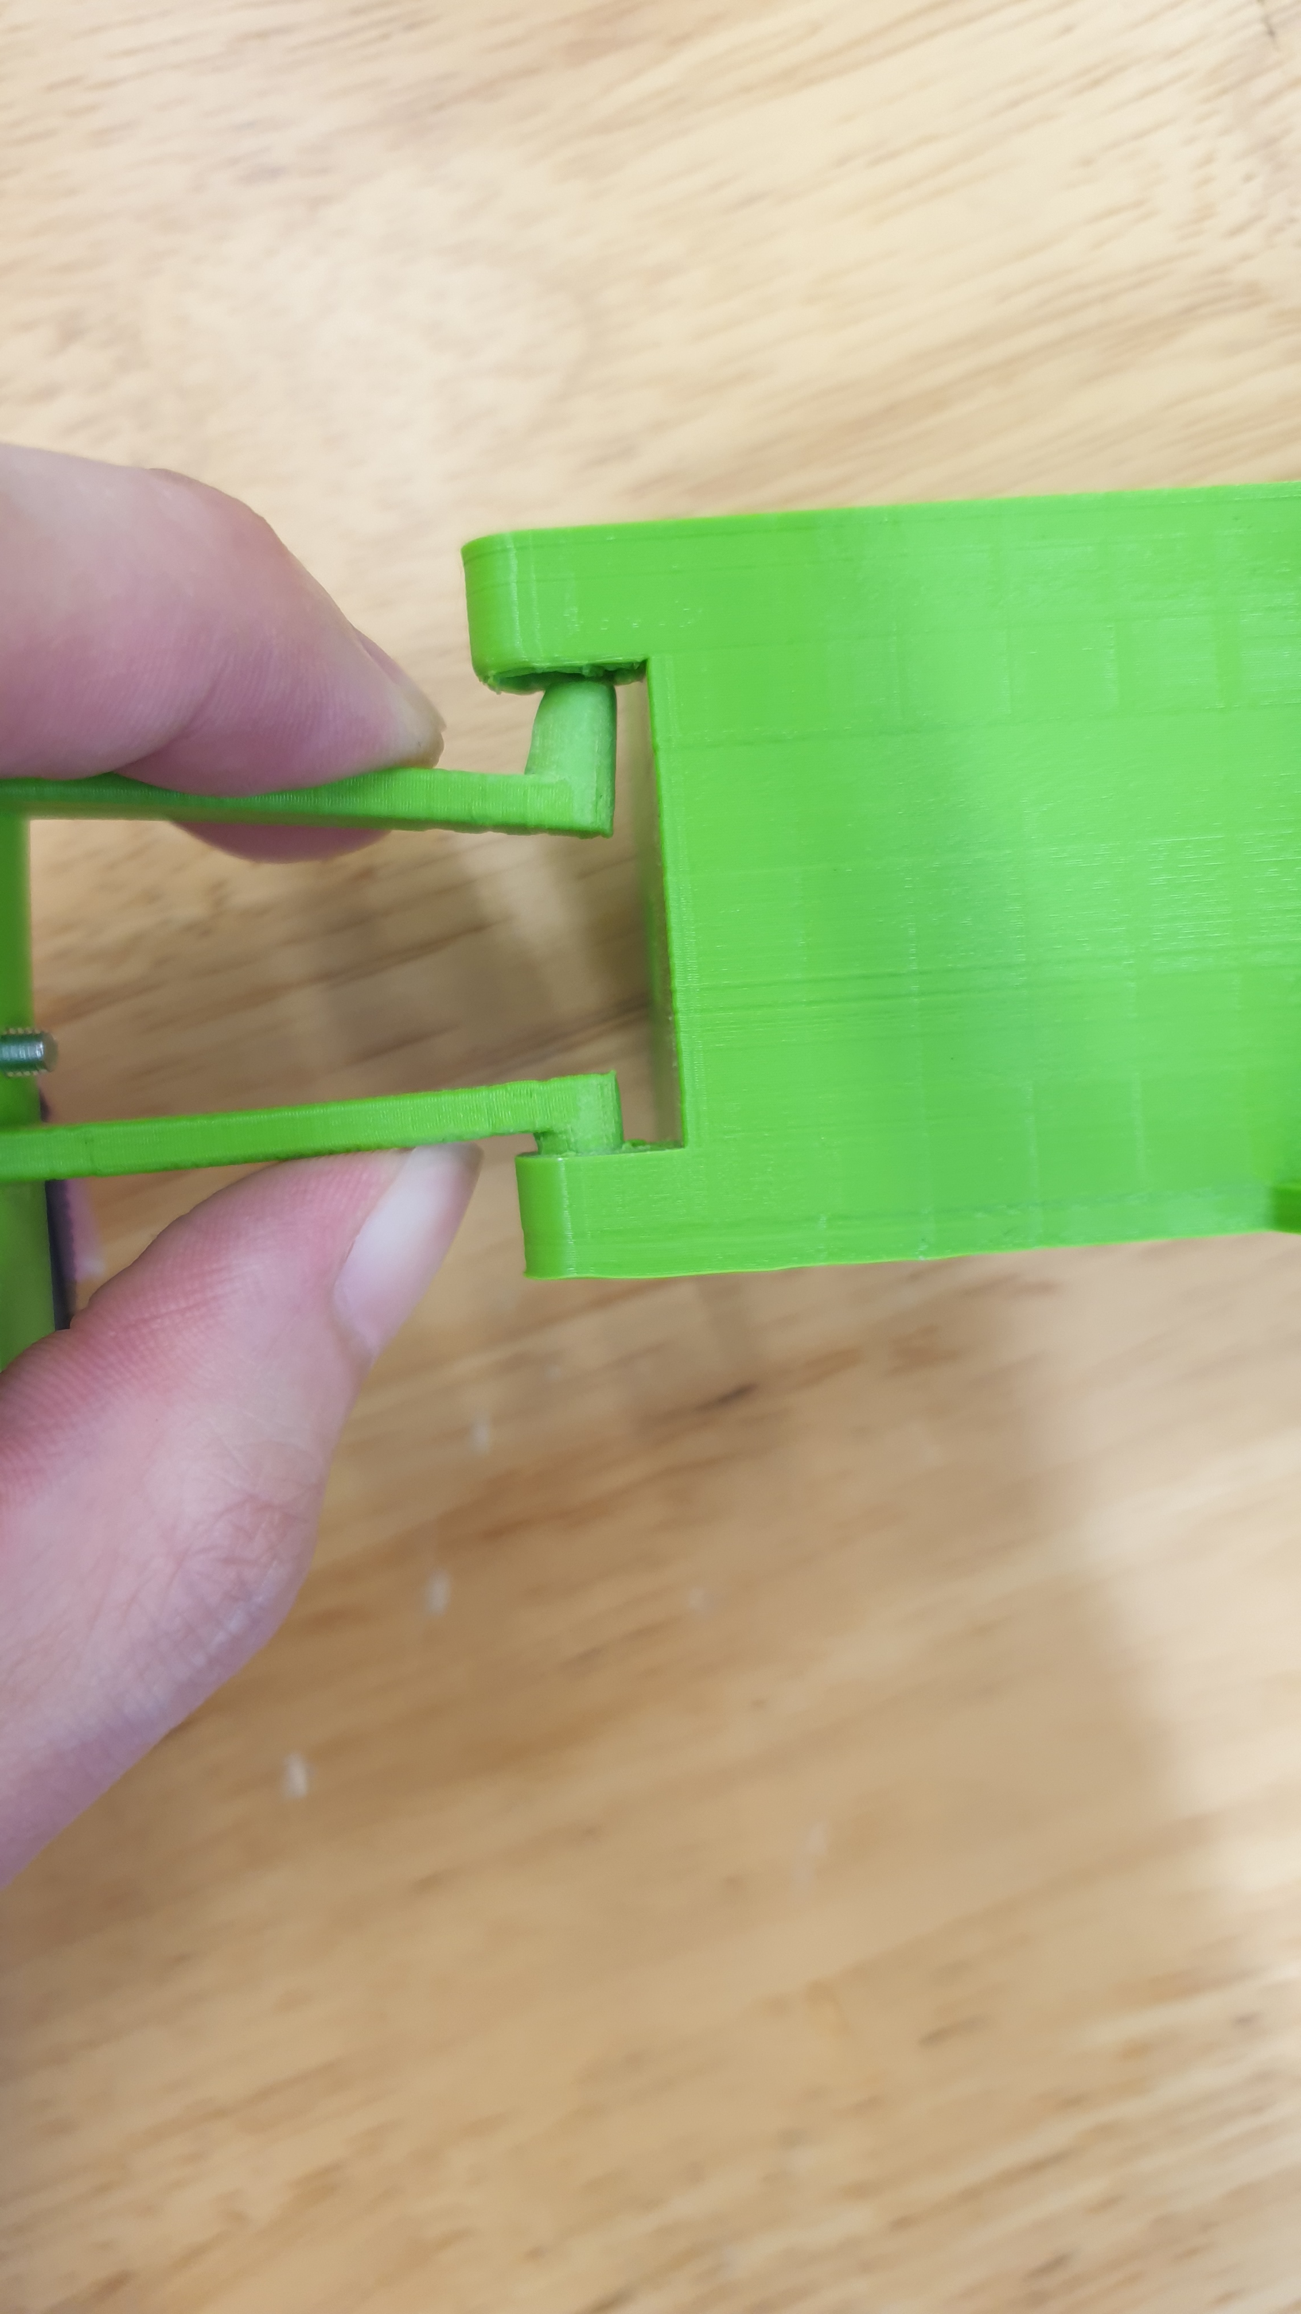
Flow Stopper
Retractable Flow Guide (RFG)
Motor Housing
Flow Guide Pivot Point
Flow Guide Retraction Motor
Retraction Cable
Pulley

Slide 10
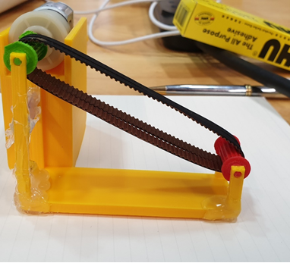
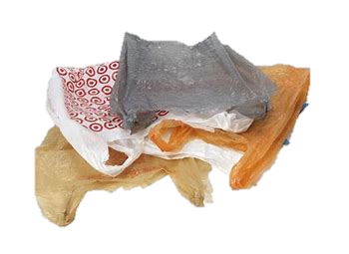
Collector Subassembly

Slide 11


12V Geared DC Motor
High water resistance
Heavy tube

Slide 12
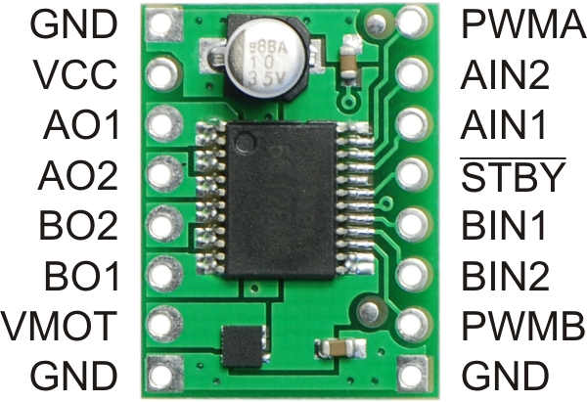
TB6612FNG-Dual motor driver
MOSFET(Metal Oxide Semiconductor Field Effect Transistor)-based H-bridges
more current to be delivered to the motors
less to be drawn from the logic supply

Slide 13
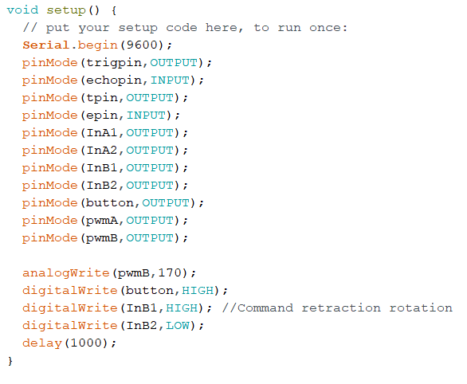
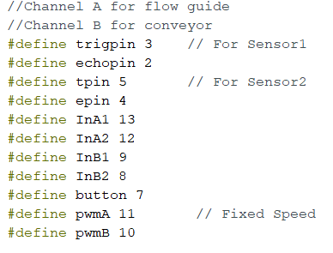
Code

Slide 14
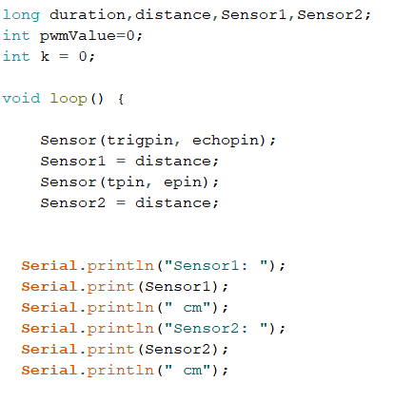
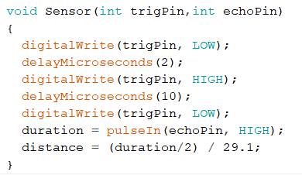

Slide 15
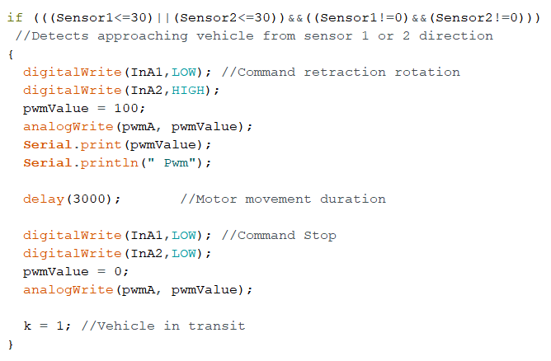
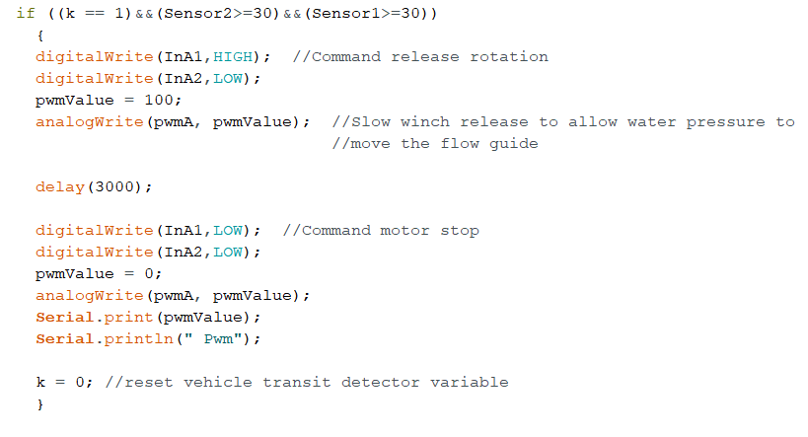

Slide 16



Slide 17
Analysis and Calculation (This won’t hurt!)

Slide 18

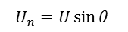
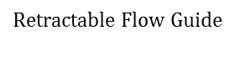
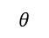
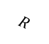

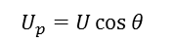
$$Retractable Flow Guide$$
Collector Station
$$R$$
$$U_{p}=U\cos{θ}{ }$$
$$θ$$
$$θ$$
$$U$$
$$U_{n}=U\sin{θ }$$
$$τ,ω$$

Slide 19
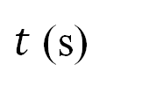

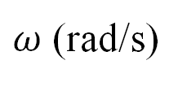

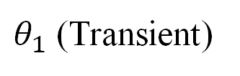
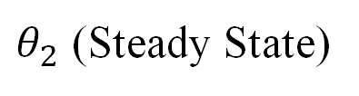
$ω$ (rad/s)
$$ω_{f}$$
$θ_{1}$ (Transient)
$θ_{2}$ (Steady State)
$$T$$
$t$ (s)

Slide 20
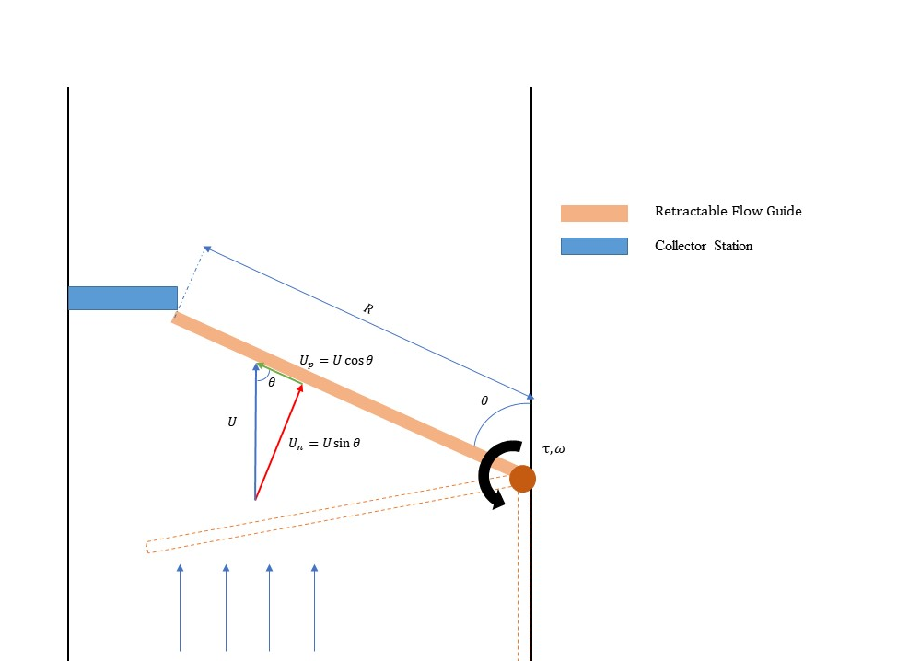
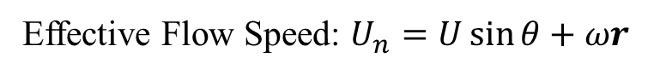
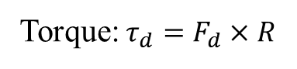

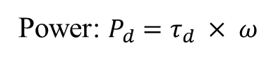
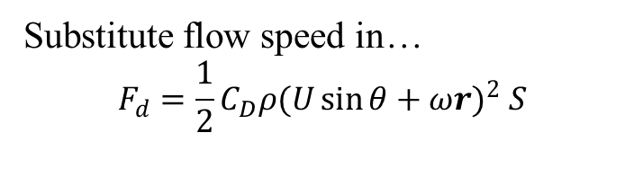
Quick Math! (Again, this won’t hurt!)
We want to find Torque, Power (and Force)!
Effective Flow Speed: $U_{n}=U\sin{θ}+ωr$
Drag Equation : $F_{d}=\frac{1}{2}ρU_{n}^{2}C_{D}S$
Substitute flow speed in…
$$F_{d}={\frac{1}{2}C_{D}ρ(U\sin{θ}+ωr)}^{2} S$$
Torque: $τ_{d}=F_{d}×R$
Power: $P_{d}=τ_{d} × ω$
But wait…

Slide 21
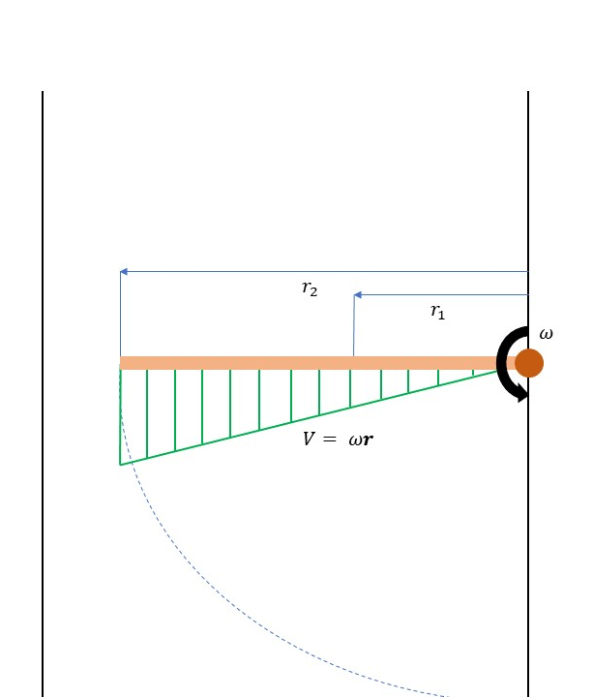
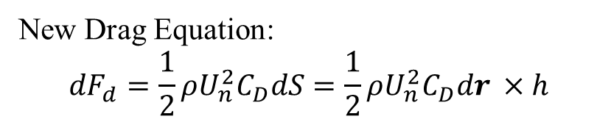
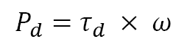

When the Flow guide rotates, the force and torque across its length is not uniform…
So we need to express the drag force in differential form and do some integration
New Drag Equation:
$${dF}_{d}=\frac{1}{2}ρU_{n}^{2}C_{D}dS=\frac{1}{2}ρU_{n}^{2}C_{D}dr ×h$$
New Torque Equation: $dτ_{d}={dF}_{d}× r$
Power Equation remains the same because speed can be expressed purely as functions of time (less work for me :D)
$$P_{d}=τ_{d} × ω$$

Slide 22
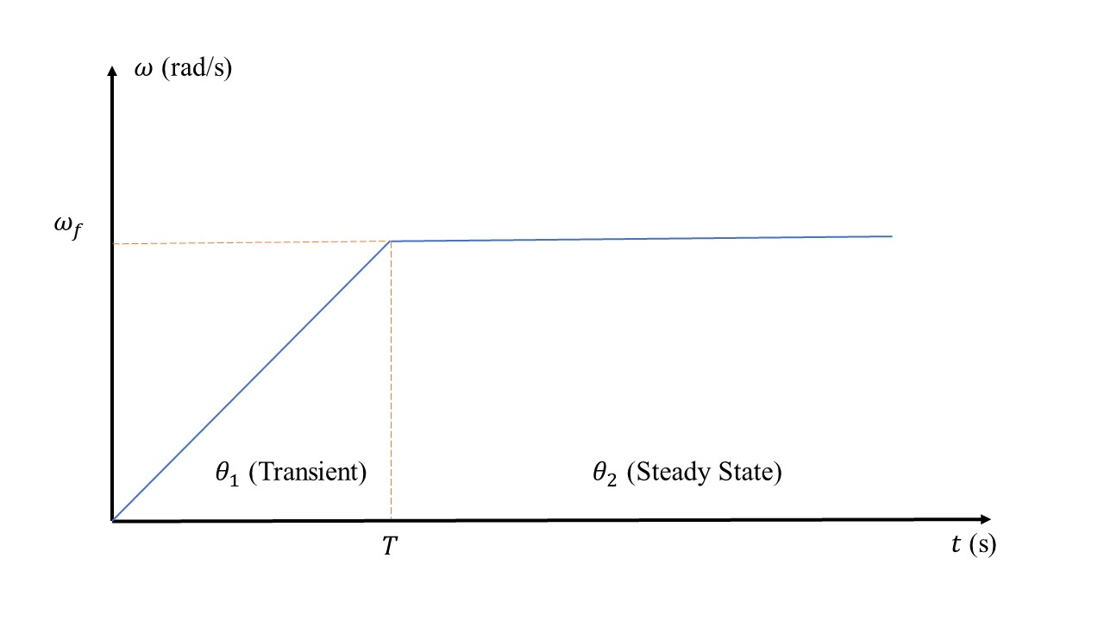
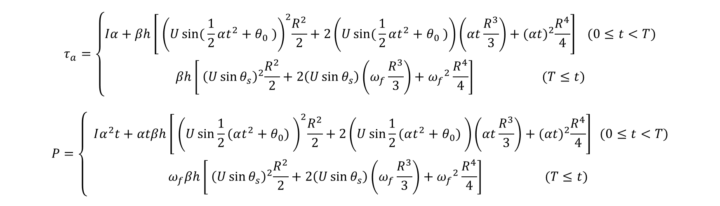
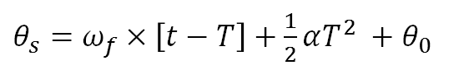
I know this looks bad but…
$$τ_{a}=\left\{\begin{aligned}Iα+βh\left[{ \left(Usin({\frac{1}{2}αt^{2}+θ_{0} )}\right)}^{2}\frac{R^{2}}{2}+2\left(Usin({\frac{1}{2}αt^{2}+θ_{0} )}\right)\left(αt\frac{R^{3}}{3}\right)+{(αt)}^{2}\frac{R^{4}}{4}\right] (0≤t<T) \\ βh\left[{ \left(U\sin{θ_{s}}\right)}^{2}\frac{R^{2}}{2}+2\left(U\sin{θ_{s}}\right)\left(ω_{f}\frac{R^{3}}{3}\right)+{ω_{f}}^{2}\frac{R^{4}}{4}\right] (T≤t)\end{aligned}\right.$$
$$P=\left\{\begin{aligned} Iα^{2}t+αtβh\left[{ \left(U\sin{\frac{1}{2}(αt^{2}+θ_{0}) }\right)}^{2}\frac{R^{2}}{2}+2\left(U\sin{\frac{1}{2}(αt^{2}}+θ_{0}) \right)\left(αt\frac{R^{3}}{3}\right)+{(αt)}^{2}\frac{R^{4}}{4}\right] (0≤t<T) \\ ω_{f}βh\left[{ \left(U\sin{θ_{s}}\right)}^{2}\frac{R^{2}}{2}+2\left(U\sin{θ_{s}}\right)\left(ω_{f}\frac{R^{3}}{3}\right)+{ω_{f}}^{2}\frac{R^{4}}{4}\right] (T≤t)\end{aligned}\right.$$
$θ_{s}=ω_{f}×\left[t−T\right]+\frac{1}{2}αT^{2} +θ_{0}$

Slide 23
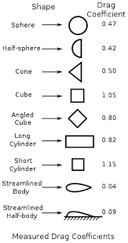
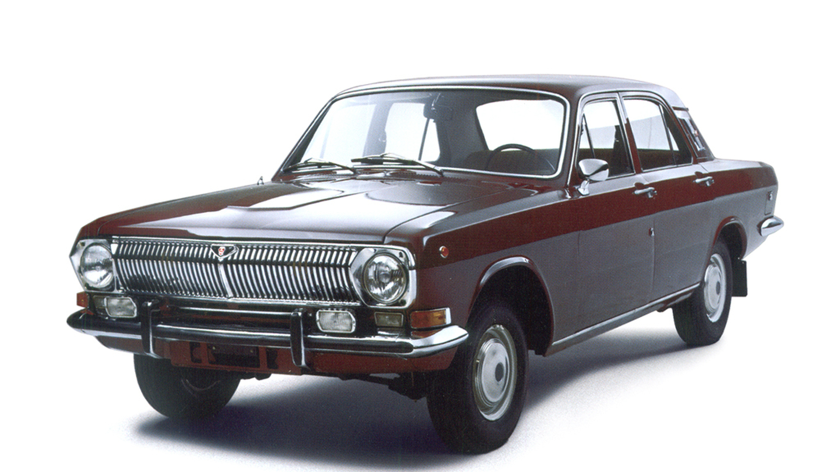
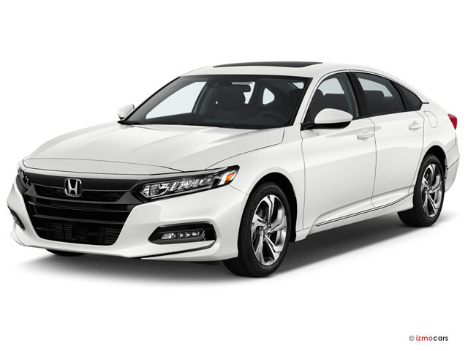
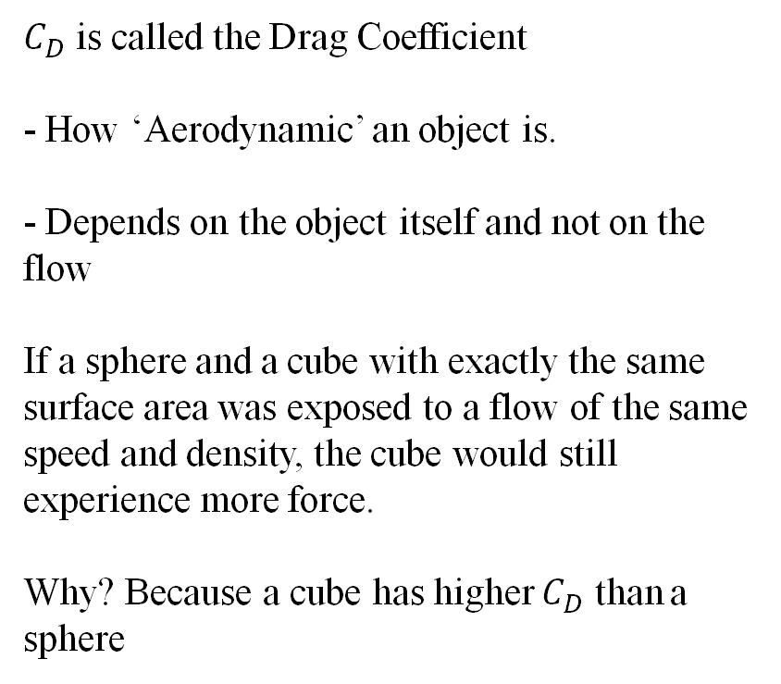

What is $C_{D}$ and how do we find it?
$C_{D}$ is called the Drag Coefficient
- How ‘Aerodynamic’ an object is.
- Depends on the object itself and not on the flow
If a sphere and a cube with exactly the same surface area was exposed to a flow of the same speed and density, the cube would still experience more force.
Why? Because a cube has higher $C_{D}$ than a sphere

Slide 24
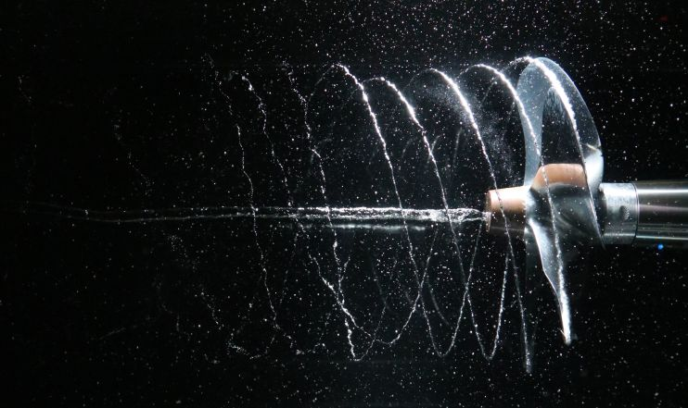
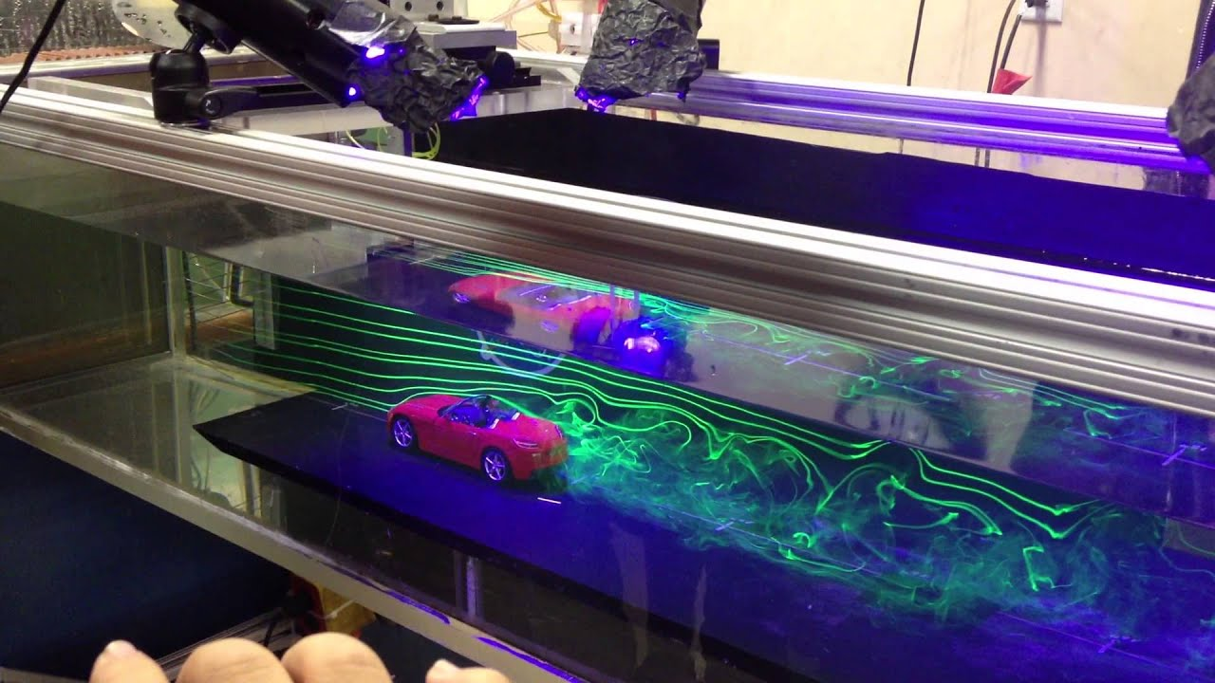
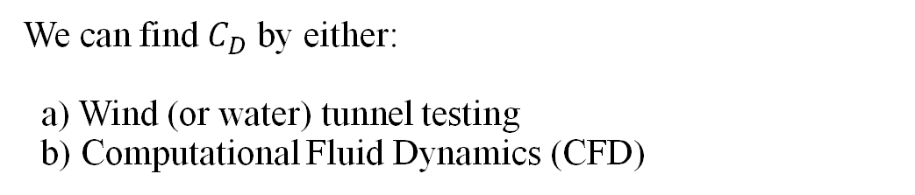
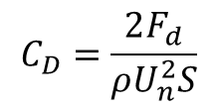
We can find $C_{D}$ by either: a) Wind (or water) tunnel testing b) Computational Fluid Dynamics (CFD)
None of us happened to have a water tunnel at home so we settled for using CFD instead
In CFD, computers are the wind/water tunnel. The computer solves really complex flow equations based on certain inputs given to it.
For our case, we are interested in the wall force caused due by drag, so we paid close attention to the velocity and pressure fields:
$$C_{D}=\frac{2F_{d}}{ρU_{n}^{2}S}$$
Yes it is the drag equation rearranged >:D

Slide 25
Nice pictures we got from CFD

Slide 26
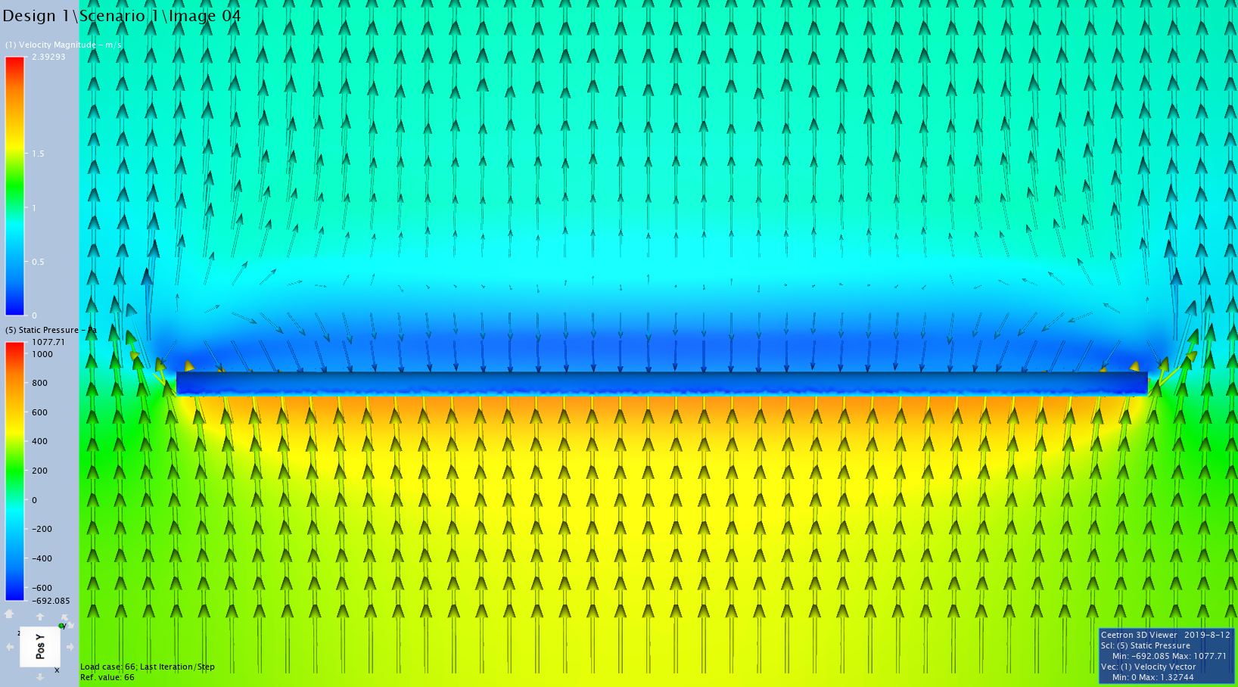

Slide 27
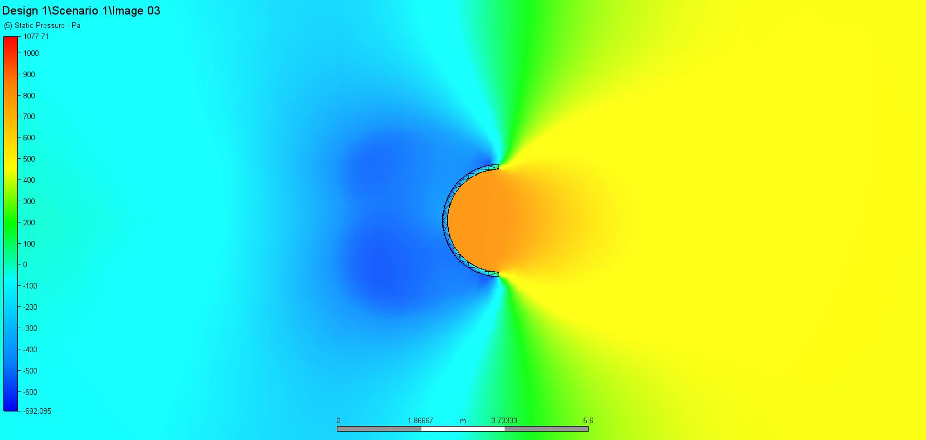

Slide 28

Really Important Results
Summary
Total area | 387.212 | m^2
TOTAL FX | -154143 | Newton
TOTAL FY | -2624.95 | Newton
TOTAL FZ | 1.83643 | Newton
Center of Force about X-Axis (Y-Z) | -0.01175 | -24.9769 | m
Center of Force about Y-Axis (X-Z) | -0.66118 | -26.4303 | m
Center of Force about Z-Axis (X-Y) | -1.77416 | 1.41123 | m
$$C_{D}=\frac{2F_{d}}{ρU_{n}^{2}S}≈2.466$$

Slide 29

MAX POWER!
Now that we have all the variables, we can finally look at the power and torque required
Before that, for context, the parameters of the problem we are trying to solve:
Parameter | Value
Angular Speed, $ω$ | 0.01, 0.02, 0.03 rad/s
Acceleration Time Period, $T$ | 30 seconds
RFG Moment of Inertia, $I$ | 37840000 kgm2
RFG Height, $h$ | 2.5 m
RFG Length, $R$ | 50
Density of Water, $ρ$ | 1000 kg/m3
Drag Coefficient, $C_{d}$ | 2.466
River Flow Speed, $U$ | 1 m/s
Initial Angular Offset, $θ_{0}$ | 0.52359878 rad

Slide 30


Slide 31


Slide 32


Slide 33
Future Improvements

Slide 34
Question Time!

Slide 35




$$r_{2}$$
$$r_{1}$$
$$ω$$
$$V= ωr$$

